Slide 1
SMART CLASS ATTENDANCE SYSTEM
Designed and Developed by
Htut Myat Moe (6709528)
Sai Kaung Htet Kyaw (6709580)
Hein Htet (6709748)

Slide 2

Challenges of Traditional Classroom Attendance
Time-Consuming
Lecturers spend several minutes calling student names every class.
Reduces valuable teaching and learning time.
Human Errors
Attendance may be recorded incorrectly.
Students can be marked absent by mistake.
Handwritten records are difficult to verify.

Slide 3
Challenges of Traditional Classroom Attendance
Duplicate or Missing Records
Paper attendance sheets can be lost or damaged.
Students may accidentally sign more than once or forget to sign.
Difficult Attendance Monitoring
Lecturers must manually calculate attendance percentages.
Finding past attendance records is slow and inconvenient.

Slide 4


Who Benefits from the Smart Classroom Attendance System?

Slide 5
Target Users
Students
Fast and easy attendance process.
Access attendance records anytime.
Increased transparency.
Lecturers
Saves teaching time.
Improves attendance accuracy.
Simplifies attendance management.

Slide 6
Target Users
Administrators
Centralized attendance records.
Easier data management.
Reduced paperwork.
Academic Departments
Access attendance reports.
Track attendance trends.
Improve academic administration.

Slide 7
User Evidence
Students
Lecturers
Administrators
Students want to check their attendance history anytime.
They prefer immediate confirmation after recording attendance.
Easy access increases transparency and reduces misunderstandings.
Lecturers need a centralized attendance dashboard.
Automatic record storage reduces paperwork.
Digital reports simplify attendance tracking and grading.
Administrators require attendance statistics and reports.
They need accurate data for monitoring and decision-making.
Centralized records improve efficiency and organization.

Slide 8
Role-Based Smart Classroom Attendance System
Module | Features | Benefits
Student | Secure login using Student ID and Password. Record attendance with one click. View personal attendance history. Receive instant attendance confirmation. | Faster attendance recording. Easy access to attendance records. Reduced attendance disputes.
Lecturer | Secure lecturer login. View attendance records in real time. Search and monitor student attendance. Generate attendance reports. | Saves class time. Improves attendance accuracy. Simplifies attendance management.
Administrator | Manage student and lecturer accounts. Monitor system usage. Maintain attendance records. Support system administration. | Centralized management. Improved data organization. Easier maintenance.

Slide 9
How the System Works
Student
Login (Student ID & Password)
Record Attendance
Attendance Stored
Lecturer Dashboard
Attendance Reports
Administrator Management
Log Out

Slide 10

Prototype Features
01
04
02
05
03
06
Secure Login
Status Management
Attendance Submission
Dashboard Metrics
Attendance History
Admin Functions

Slide 11
ID & Password Authentication
Students log in using their Student ID and Password.
Role-based access for Students, Lecturers, and Administrators.
Secure authentication before accessing the system.
Attendance Submission
One-click attendance recording.
Instant confirmation after submission.
Prevents duplicate attendance entries.
Attendance History
Students can view previous attendance records.
Displays attendance date and status.
Promotes transparency and self-monitoring.

Slide 12
Search & Filter
Search attendance records by Student ID or Name.
Filter records by class, date, or attendance status.
Quickly locate specific attendance information.
Admin Functions
Manage student accounts.
Manage lecturer accounts.
View all attendance records.
Generate attendance reports.
Maintain system data.
Status Management
Manage attendance status: Present, Late, Absent
Easy updates for lecturers and administrators.
Dashboard Metrics
Total students
Present today
Absent today
Attendance percentage
Quick attendance summary

Slide 13
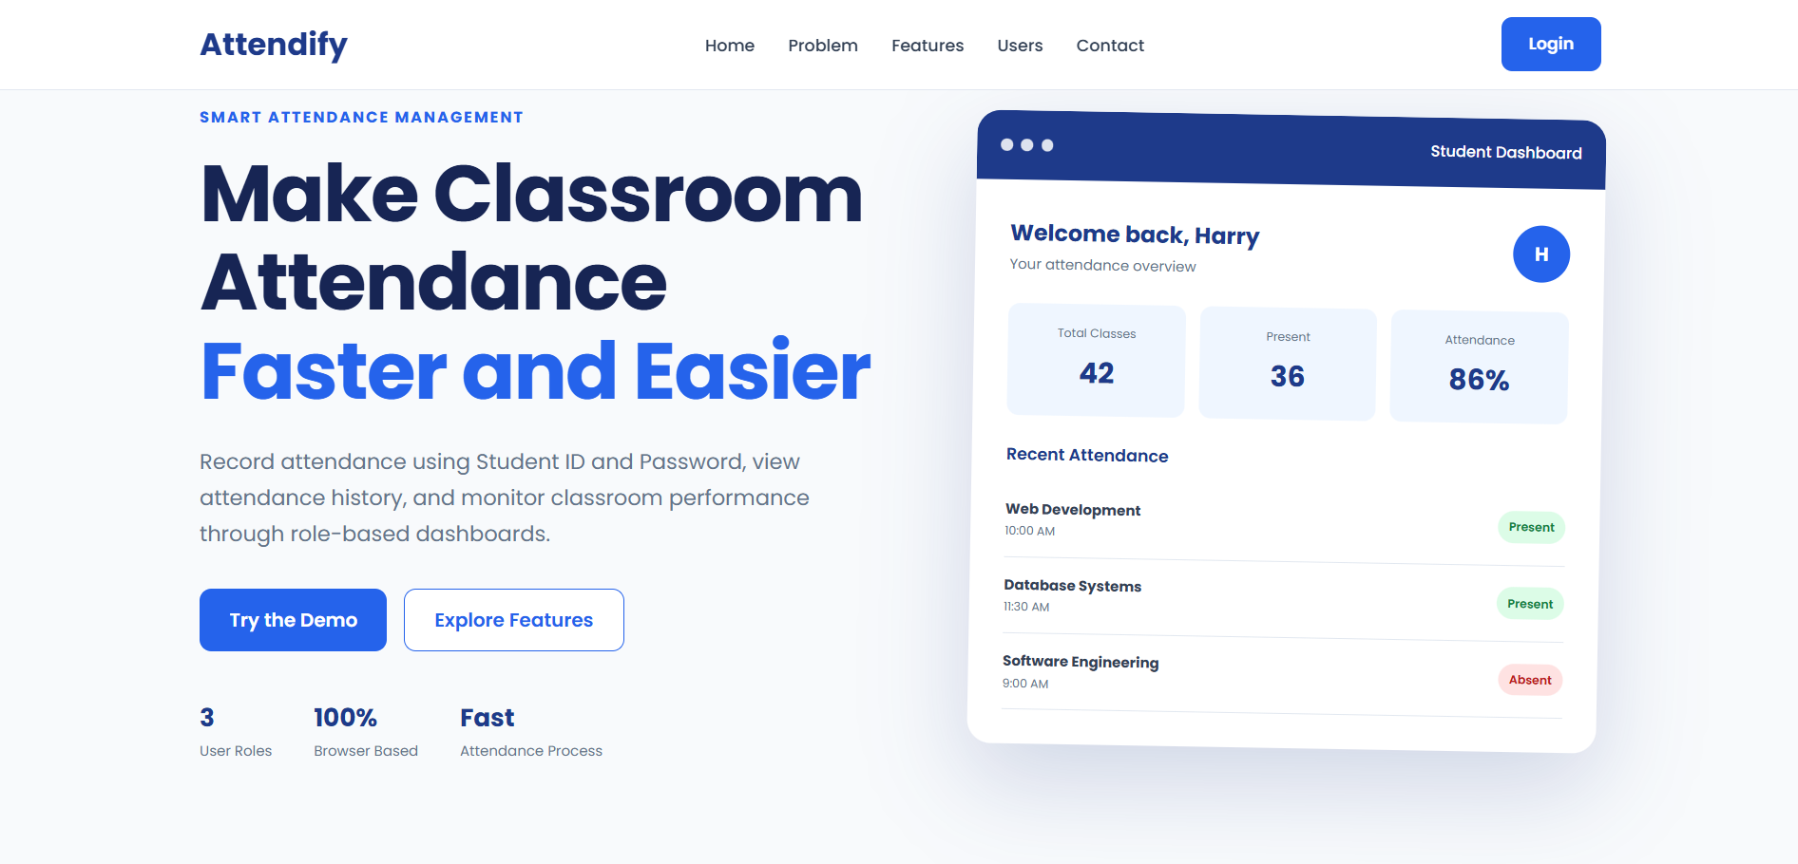
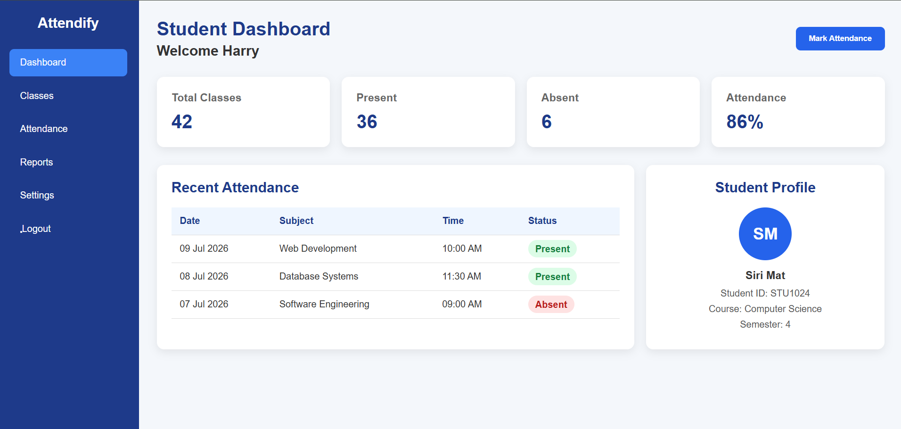
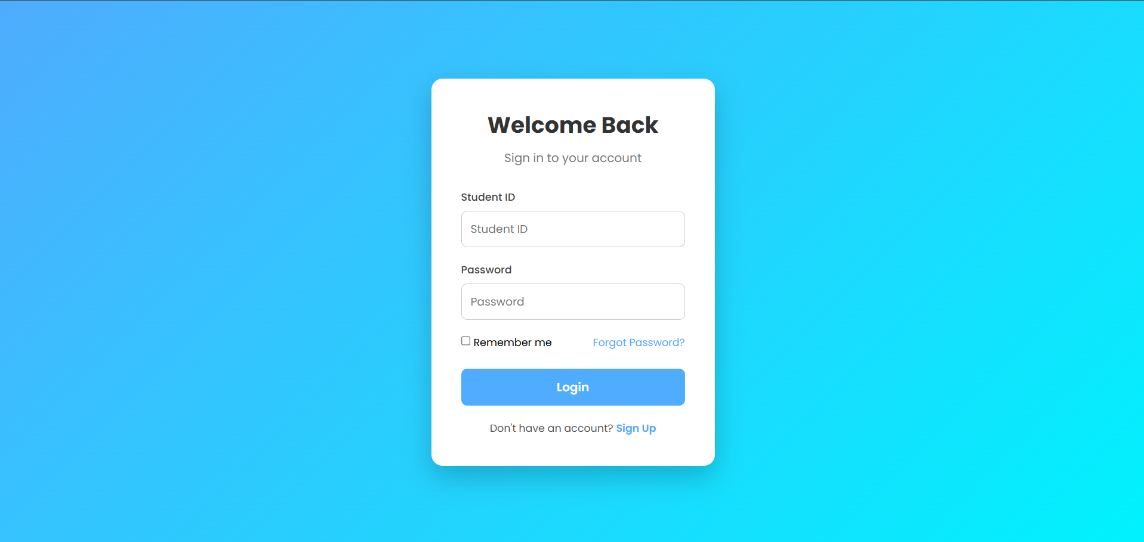
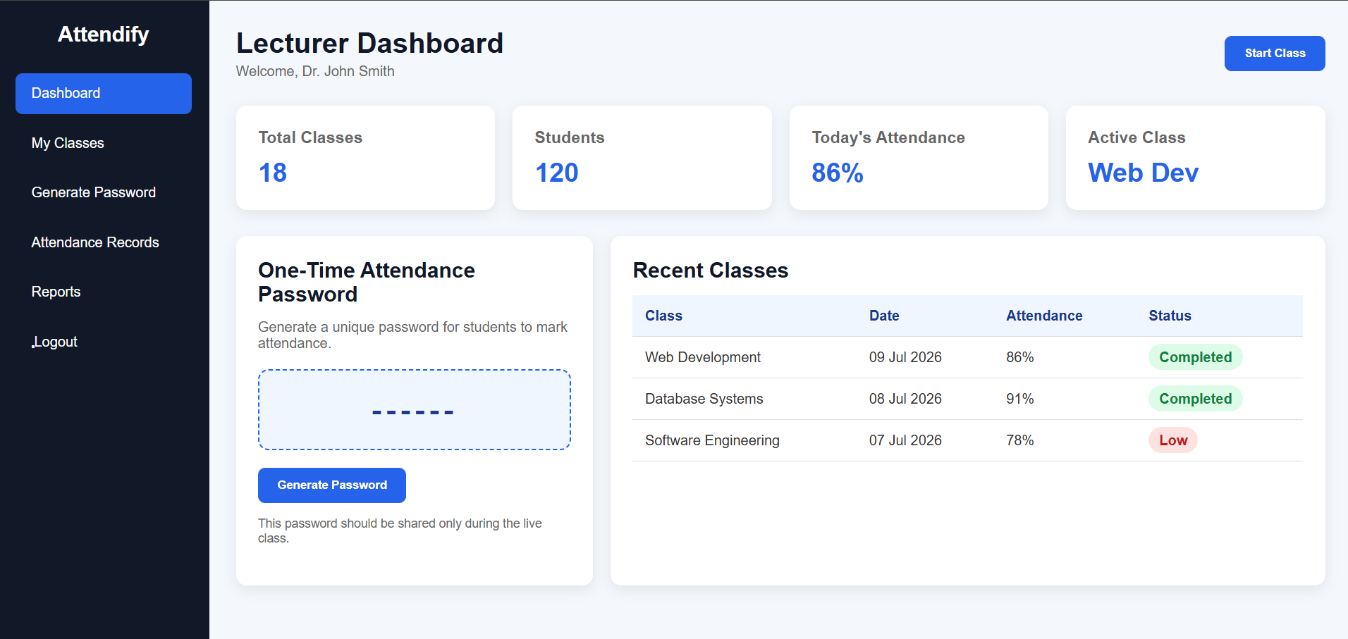
Product Demonstration

Slide 14
Validation Results
10 participants
100%
Metric | Result
Login Success Rate | 100%
Attendance Recording Success | 100%
Task Completion Rate | 100%
Average Completion Time | 22 seconds
User Satisfaction | 4.8 / 5
Would Recommend the System | 100% YES
tested the prototype.
completed the core system tasks.
User Feedbacks
Students
Attendance recording is quick and easy.
Attendance history is useful.
The interface is simple to understand.
Lecturer
Dashboard makes attendance monitoring easier.
Reports are clear and save time.
Administrator
User management is straightforward.
Attendance records are well organized.

Slide 15
Current Limitations
Browser Local Storage Only
No Password Encryption
Attendance data is stored in the browser's Local Storage.
Data may be lost if the browser cache is cleared.
Not suitable for long-term or large-scale deployment.
Passwords are stored without advanced encryption.
Current authentication is suitable only for prototype purposes.
Future versions should implement password hashing and secure authentication.
No Centralized Database
Single-Device Data
Data is not shared between different devices.
Lecturers and administrators cannot access the same records from multiple computers.
Future versions should use a cloud or SQL database.
Attendance records are available only on the device where they were created.
Users cannot synchronize data across multiple devices.
Cloud synchronization is planned for future development.

Slide 16
Future Improvements
Secure Backend
Institutional User Management
Replace browser Local Storage with a secure backend server.
Implement user authentication and authorization.
Encrypt sensitive user information and passwords.
Improve system reliability and data security.
Integrate with the university's Student Information System (SIS).
Automatically import student and lecturer accounts.
Support multiple faculties, departments, and courses.
Simplify user administration.
Cloud Database
Store attendance records in a cloud database (e.g., MySQL, PostgreSQL, Firebase).
Enable secure backup and recovery.
Allow access from multiple devices.
Improve scalability for larger institutions.

Slide 17
Future Improvements
Real-Time Synchronization
Advanced Reporting
Synchronize attendance records instantly across all devices.
Allow lecturers to monitor attendance in real time.
Ensure data consistency for students, lecturers, and administrators.
Support live classroom updates.
Interactive attendance dashboards.
Export reports to PDF, Excel, and CSV.
Attendance trends and analytics.
Early identification of students with low attendance.
Mobile-Responsive Improvements
Optimize the interface for smartphones and tablets.
Improve usability on different screen sizes.
Develop a dedicated Android and iOS application in the future.
Enable convenient attendance management on mobile devices.

Slide 18
THANKS
Presented by HEHe
Htut Myat Moe
Sai Kaung Htet Kyaw
Hein Htet

